Slide 1
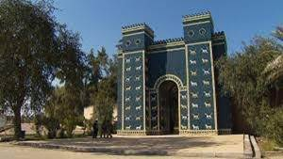


University of Babylon
Waste sorting and recycling program
Program Central Committee
Dr. Huda S. Alhasan,
Osamah J. Oudah,
Nawfal A. Salih
Environmental Research and Studies Centre, University of Babylon, IRAQ
Dec.2018 – Oct. 2019

Slide 2

University of Babylon Waste Program is sponsored by:

Slide 3
Contents
Reasons for launching the program
Program implementation sites
what is the program
Program benefits
Program Requirements
Germany

Slide 4
Reasons for launching the program

Slide 5

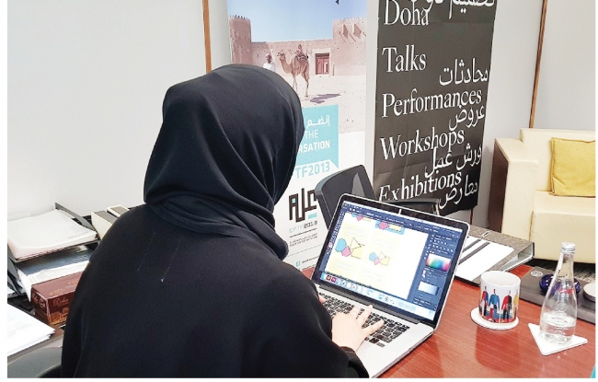
1- Applying scientific and academic information gained on the ground and to treat pollution resulting from waste

Slide 6
2-The deteriorating situation as a result of the random dumping of waste throughout the province of Babylon

Slide 7
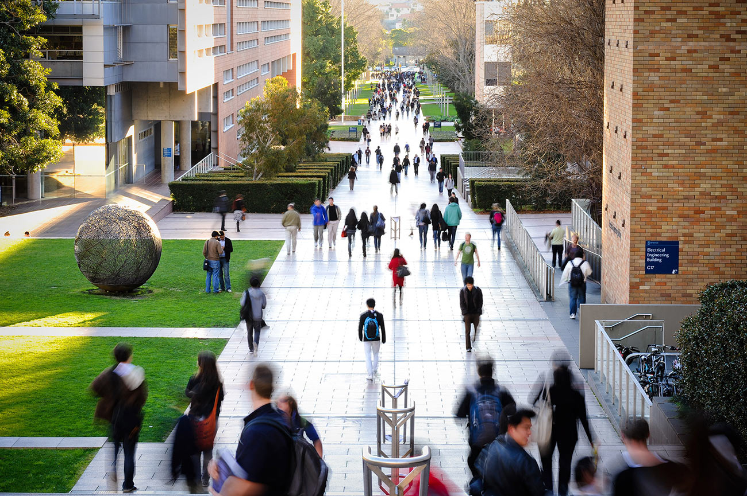
3-Create a clean university environment and take off to the outside world

Slide 8
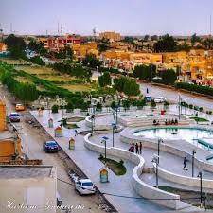
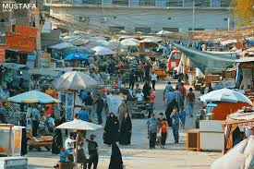
4-Educate the Babylonian community

Slide 9
What is the program

Slide 10
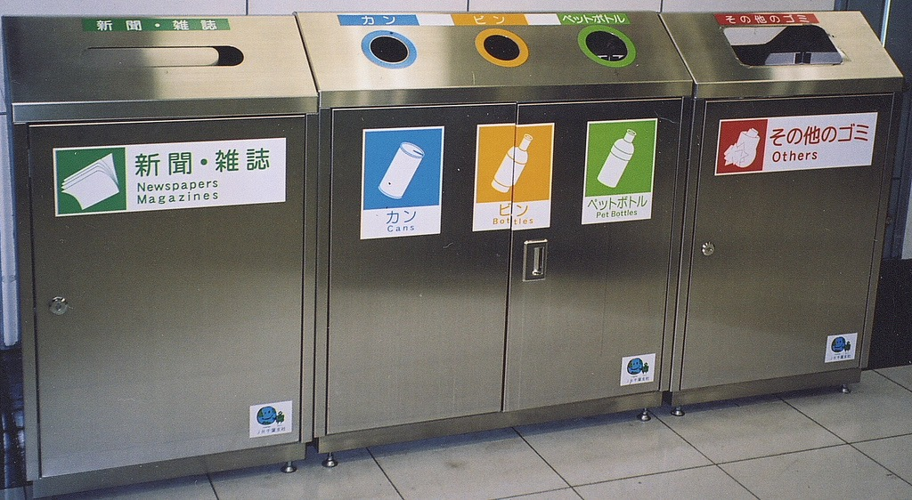
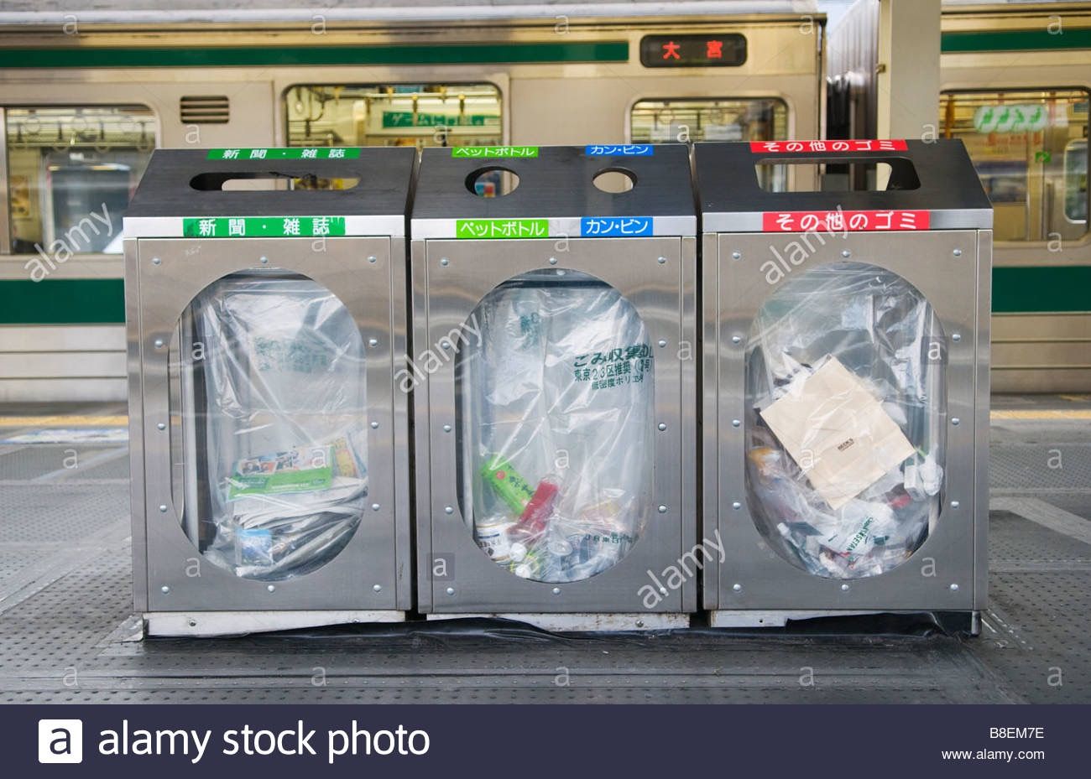
Purchasing or forming the containers of classified containers for sorting waste according to their categories, taking into consideration the presence of signs indicating the type of waste
Type of large waste structures - outside buildings

Slide 11
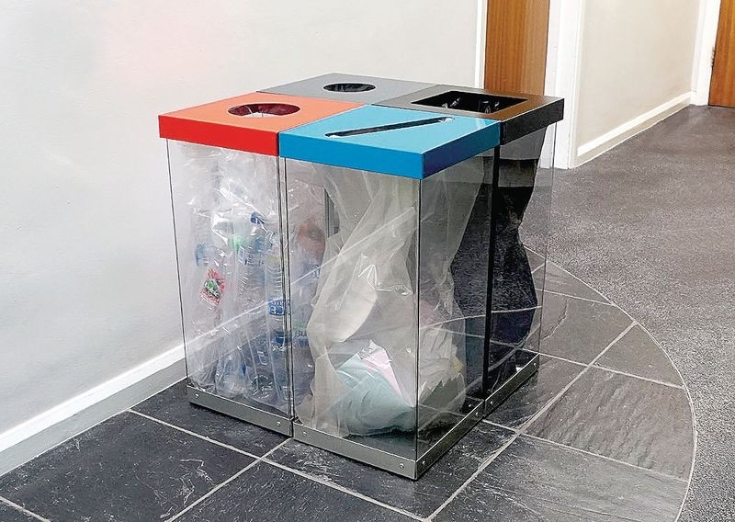
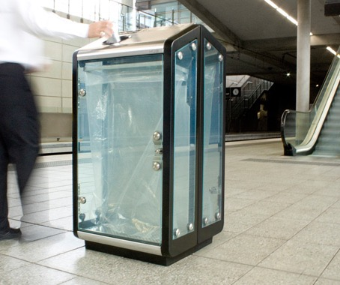

Waste structures - inside buildings
Waste structures - outside buildings

Slide 12
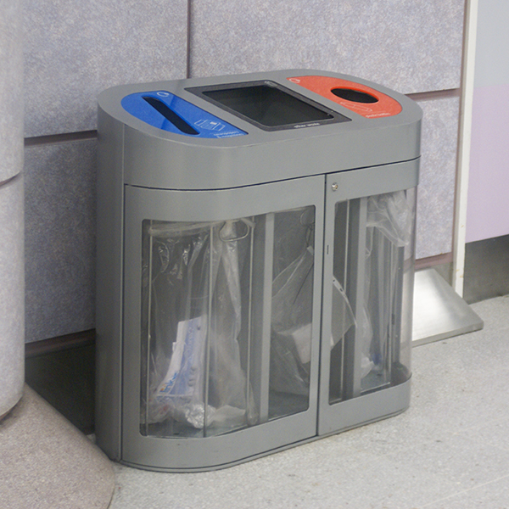
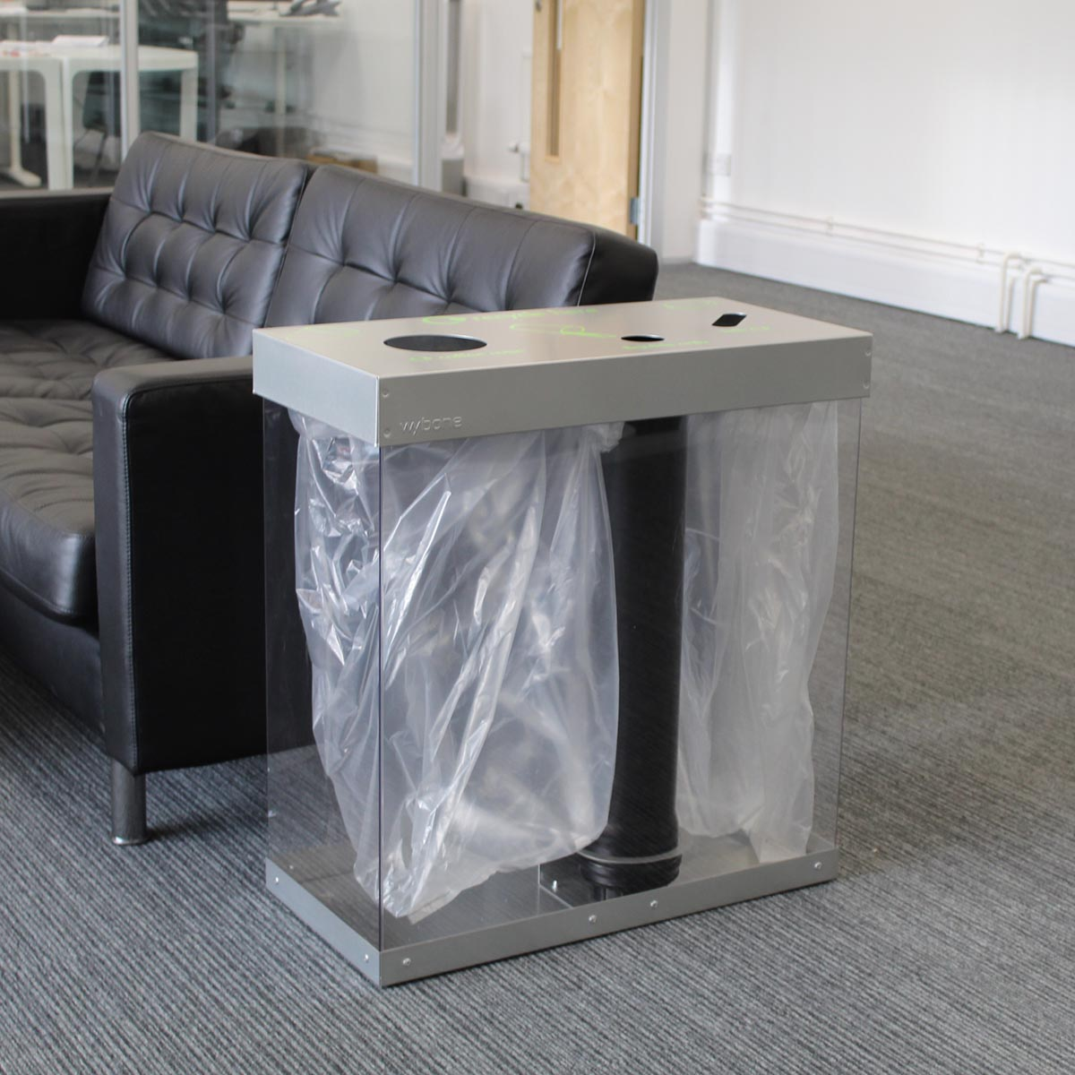
Waste structures - inside buildings

Slide 13
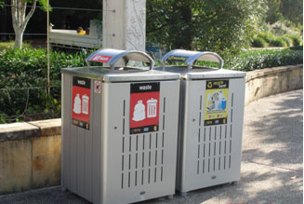
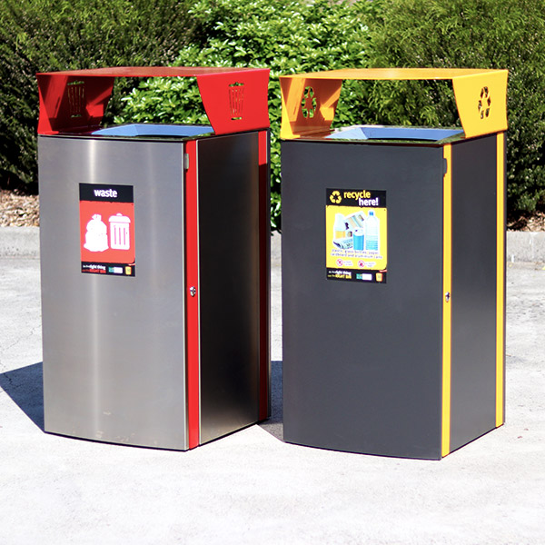
Other models are made of aluminum

Slide 14
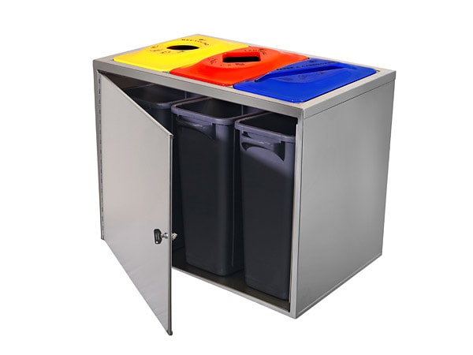
How to put containers inside structures

Slide 15
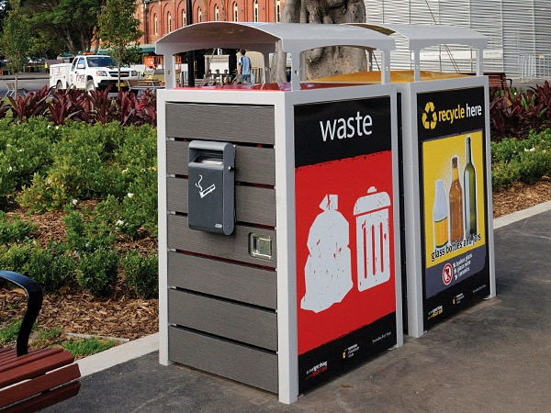
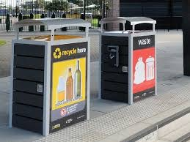
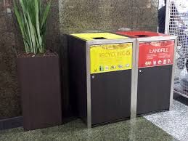

Slide 16
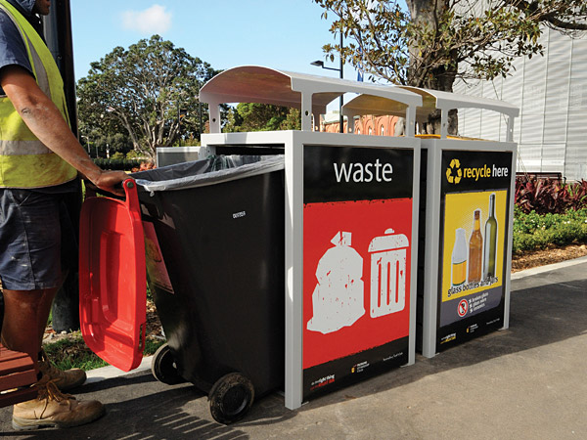
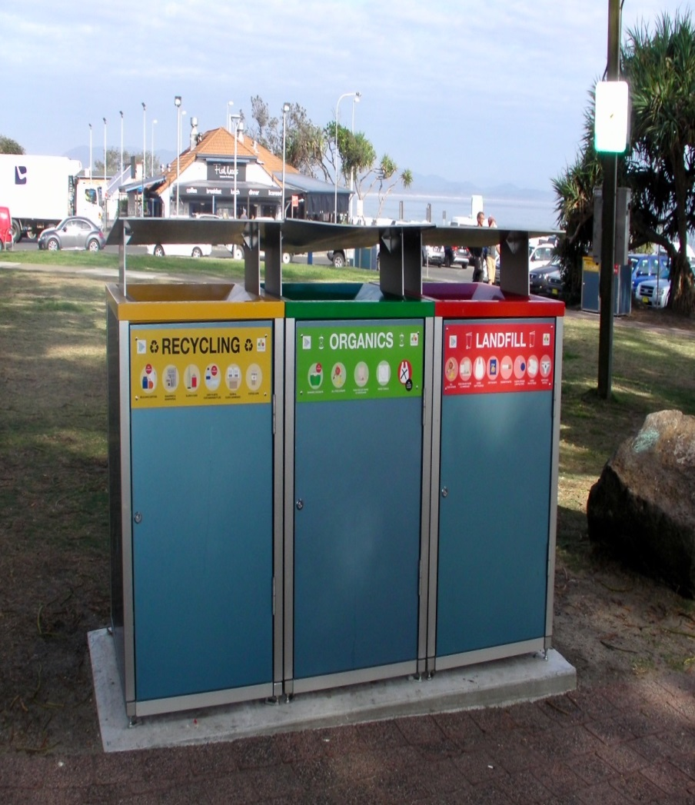
Method of placing waste container
Put the concrete under the outer structure

Slide 17
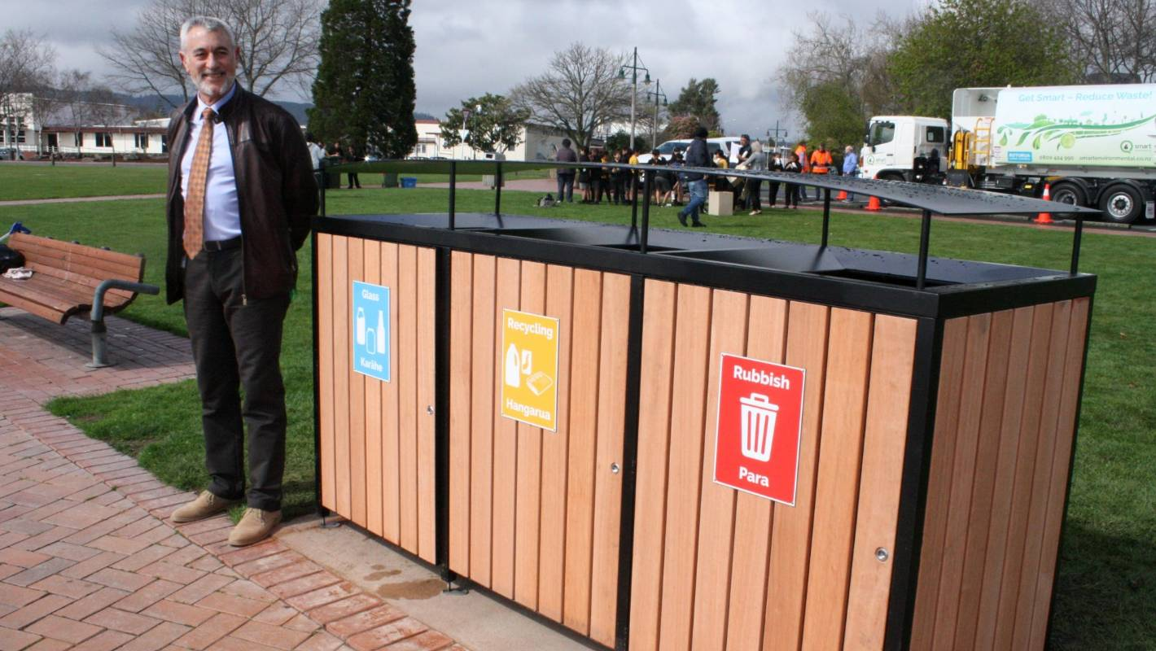
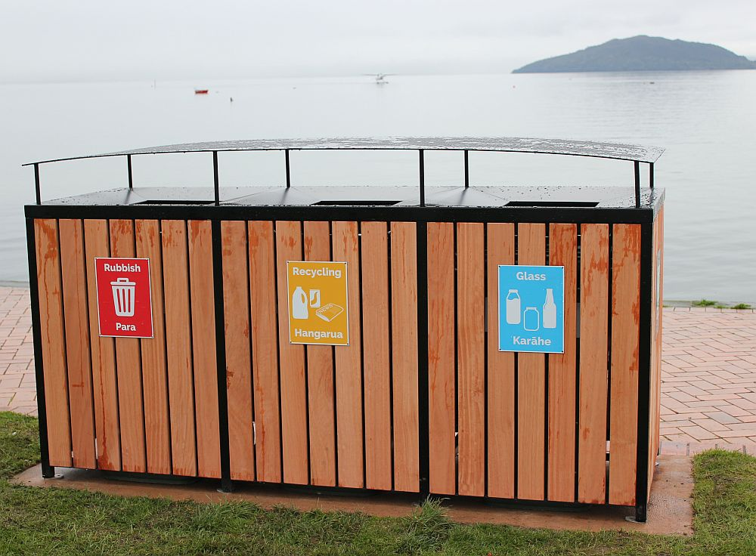
Other exterior models (wooden)

Slide 18
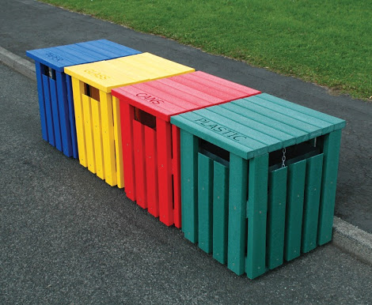
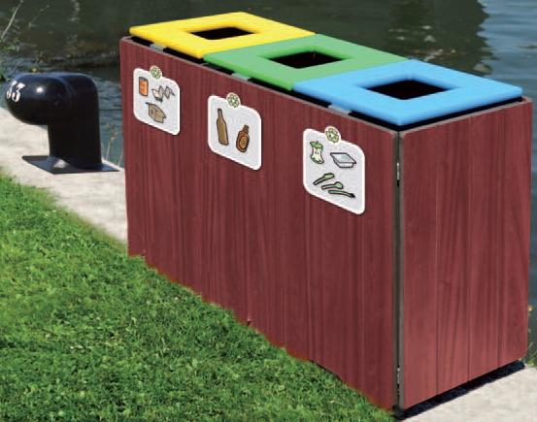


Slide 19
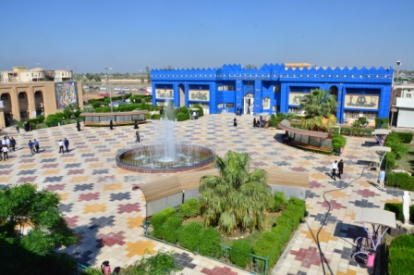
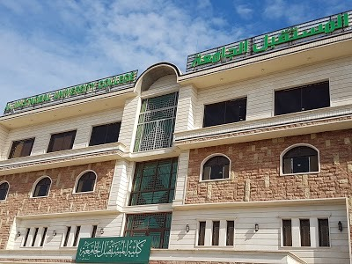



Program implementation sites

Slide 20
The activities carried out by employees on this program
1. Educating the undergraduate student in waste sorting.
2. Install structures in pre-diagnosed locations.
3. Distribution of information posters to the work of the program for colleges and departments within the University of Babylon.
4. Encourage students to be the nucleus for the sustainability of the university environment.
5. Follow-up and maintenance of the program.

Slide 21
Program Requirements

Slide 22
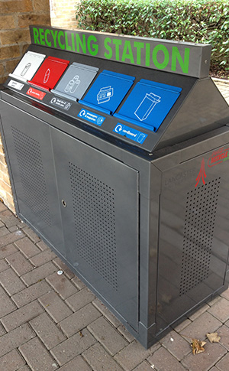

1- Fixed container structures

Slide 23
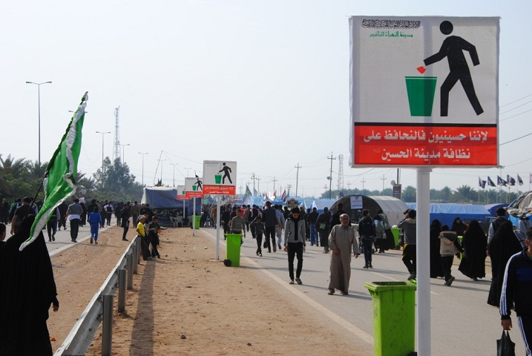
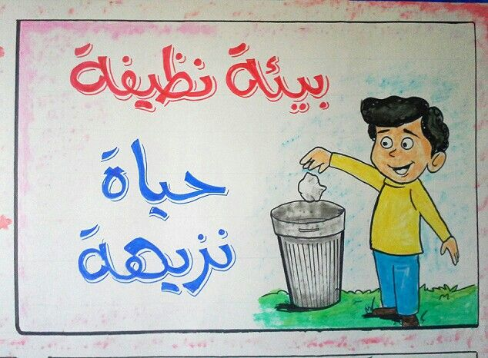
2- Equipment for volunteer staff
Posters

Slide 24
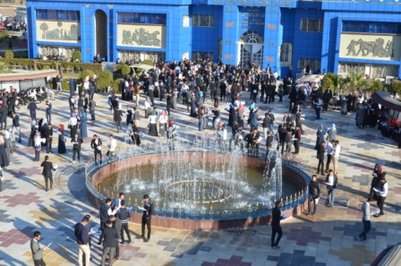
3- Students

Slide 25
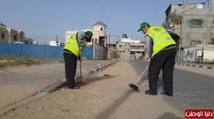


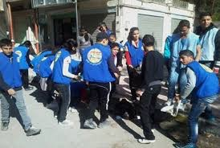
4- T-shirts bearing the logo of those responsible for the program

Slide 26
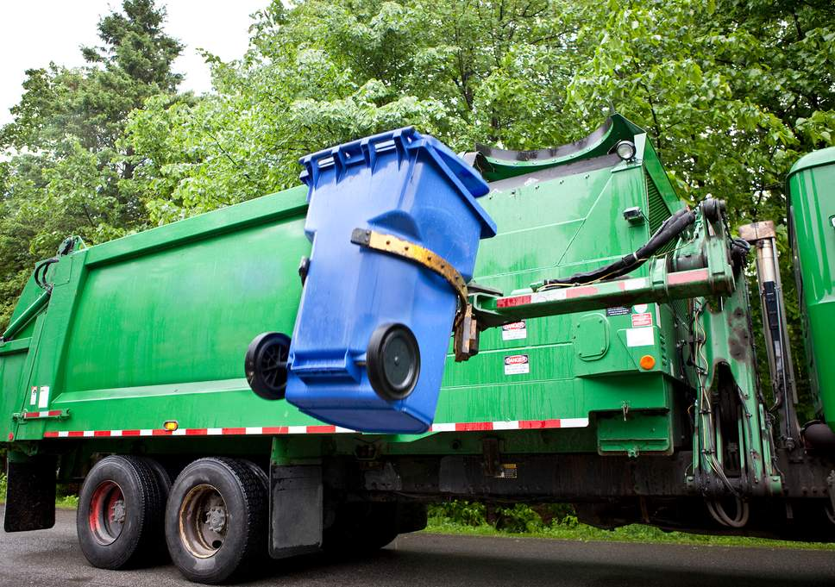
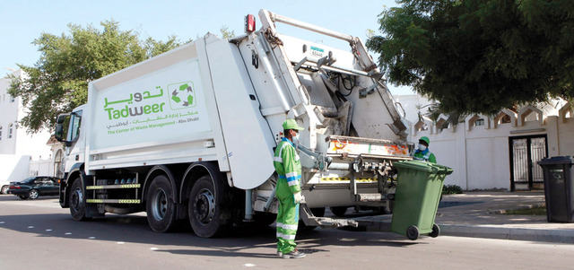
5- Cars

Slide 27
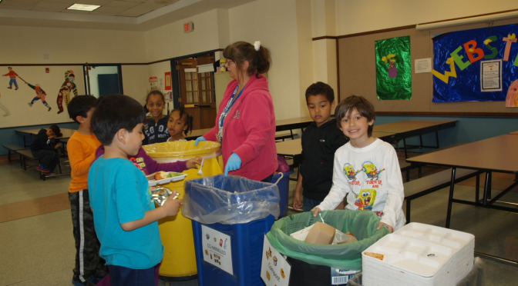
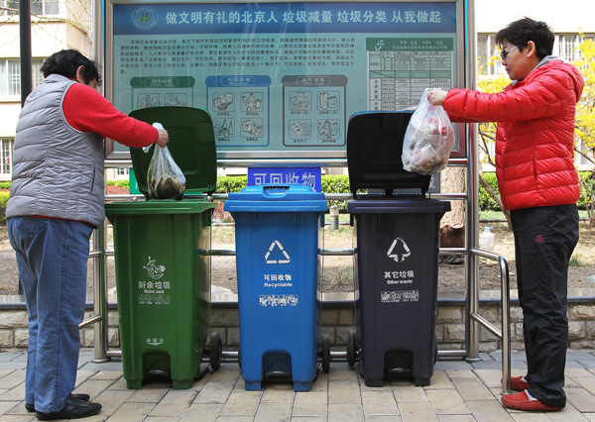
Program benefits
Spread the culture of waste sorting among the community

Slide 28
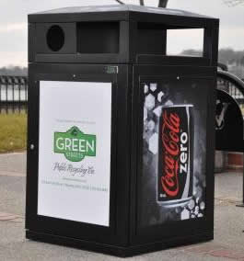
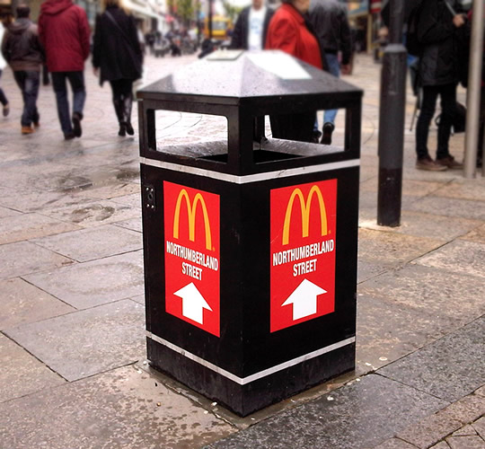
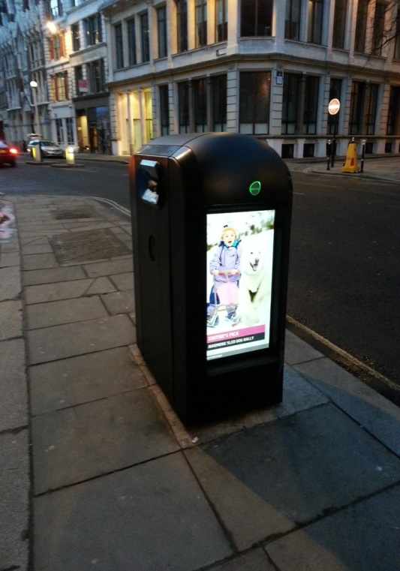
The container logo can be used as a source of advertising for the rest for many years
Not a temporary idea compared to previous work

Slide 29

Waste Recycling

Slide 30
Benefits of recycling
There are at least five benefits for recycling solid waste:
Economic
Environmental
Employee Morale
Corporate Image
Compliance

Slide 31
Economic
Potential economic advantages of waste prevention include:
Reduced waste disposal fees
Revenues from recycling commodities

Slide 32

Environmental
The environmental benefits include:
Reduced energy consumption
Reduced pollution
Conservation of natural resources
Extension of valuable landfill capacity
Stimulates the development of greener technologies
Prevents emissions of many greenhouse gases and water pollutants
Notes:
Employee Morale
Employees morale improves when they see the company taking steps to reduce waste through recycling
This heightened morale could increase employee enthusiasm, productivity and more waste prevention measures
Some companies use recycling revenues for employee recreation (I.e. picnics, holiday parties etc.)
Corporate Image
When customers and the surrounding neighborhoods see that the company is environmentally conscious, it creates a favorable image of the company
An enhanced corporate image might attract customers
Surveys show that more and more consumers consider a firm's environmental record when making purchasing decisions
Compliance
Reducing solid waste through recycling can also mean compliance with local or state solid waste regulations
Some communities also restrict the amount or types of waste accepted at solid waste management facilities
By implementing an aggressive recycling program, your business can help ensure compliance with these requirements

Slide 33

What are the waste that turn into compost
List of Acceptable Items:
Fruits and vegetables
Meat, including bones
Dairy
Soup and sauce
Bread products
Coffee grounds and filters
Waxed paper
Cooking Fat
Paper plates
Napkins
Paper towel
Milk cartons
Paper coffee cups
Wooden Skewers

Slide 34
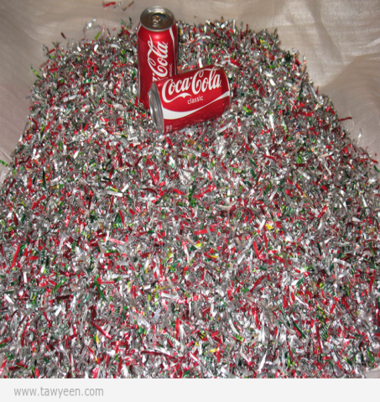
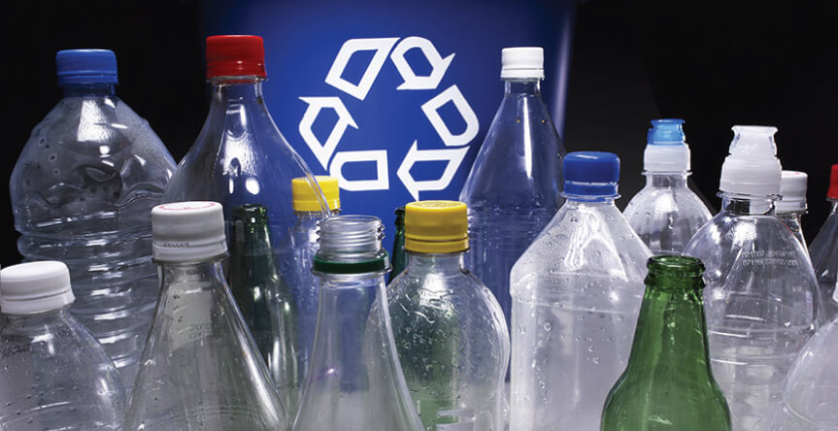
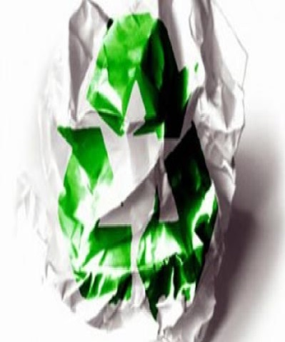
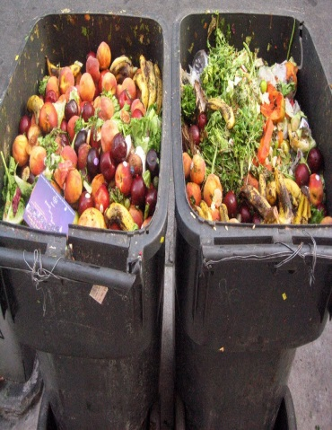
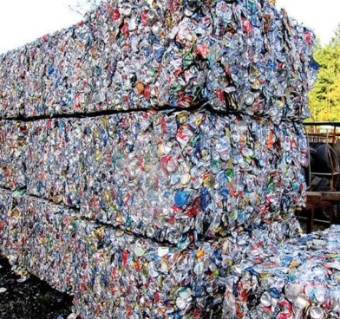
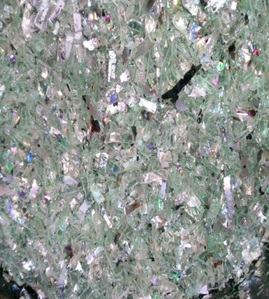
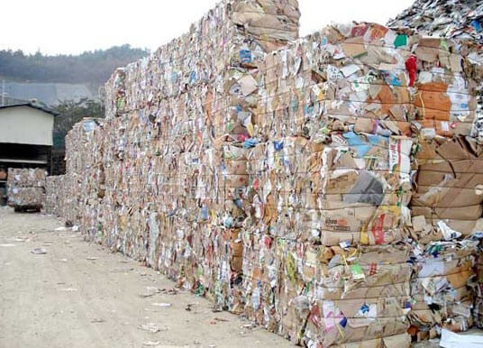

Waste recycling extract (paper, aluminum, plastic, food)

Slide 35

Germany

Slide 36
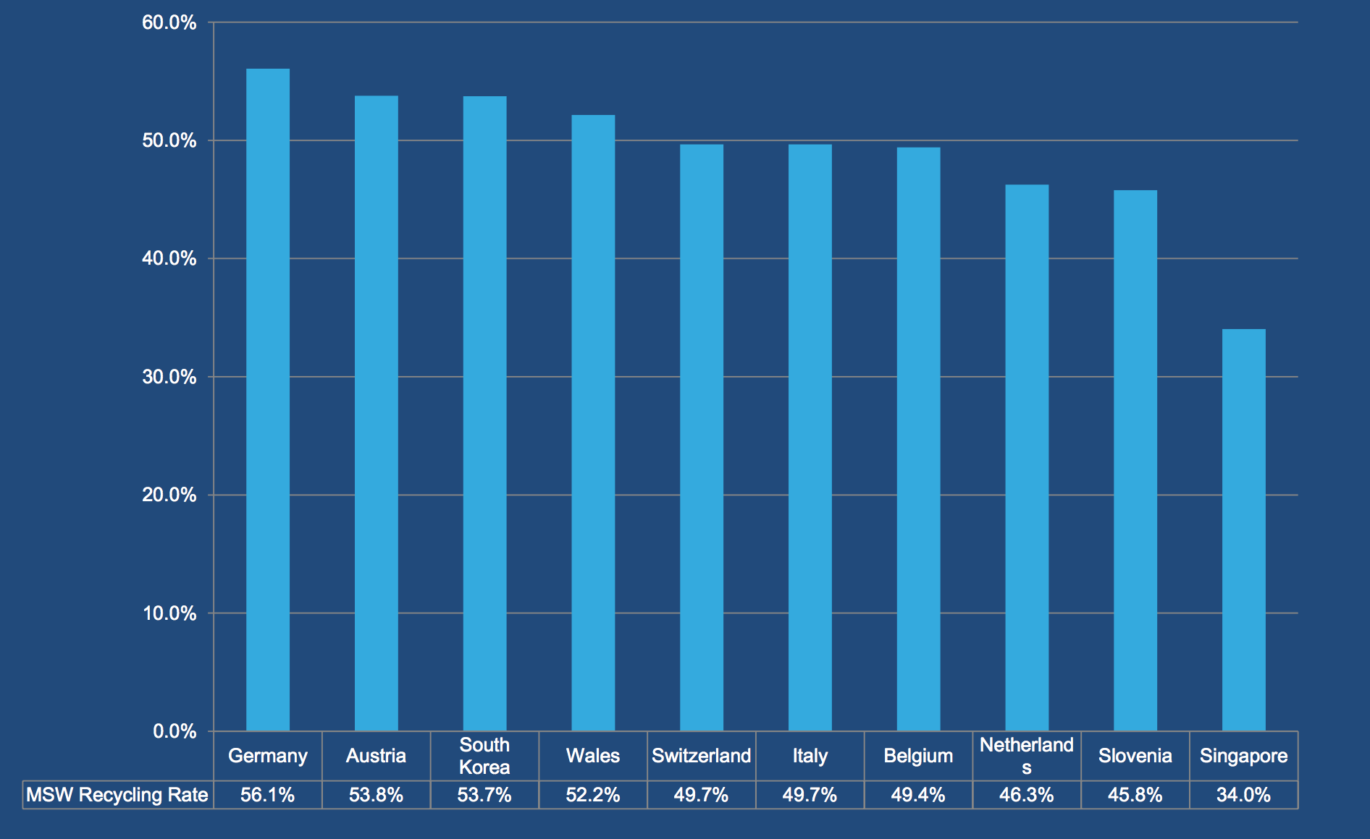
Top 10 Recycling Rate Countries - MSW
Ref: European Environmental Bureau https://eeb.org/publications/83/waste-and recycling/84241/report-on-global-recycling-rates.pdf
Notes:
According to the European Environment Agency (2013), Germany was one of the first European countries to introduce landfill limiting policies in the 1990s. These included schemes for collecting packaging waste, bio-waste and waste paper separately. By 2001, Germany recycled about 48% of its municipal waste (just above NI’s current level of 46.2% (as of June 2016)).9 This increased to 62% in 2010 (well beyond the EU 2020 target of 50%), landfilling was almost 0% and incineration 37%.10 See Fig 3. Eurostat data for 2014 shows that Germany has the highest recycling and compost rate for municipal waste of all EU Member States, at 64%11. However, removing composting from the equation, Germany’s material recycling rate alone is 47%, just behind Slovenia at 49%, showing that Germany also has a strong approach to composting.12 Germany has experienced year on year growth of overall recycling since 2001, in fact, as shown in Fig 4, by the early 2000s, Germany had met and surpassed the EU 2020 target of 50%. The German Government has in fact set an ambitious target: “to achieve almost complete high-quality recovery, at least of municipal waste, by 2020.”13 However, it should be noted that Germany’s sharp growth in recycling slowed by the latter part of the 2000s as shown in Fig 4, and continues to do so. For example, Germany reached 64% back in 2008, and has fluctuated a degree or two since then to remain at 64% in 201414. For this reason, future projections by the EEA indicate that efforts will need to be continued to maintain and increase Germany’s already high recycling rates.15

Slide 37
Treatment Rate
Ref: Eurostat (2016) http://ec.europa.eu/eurostat/documents/2995521/7214320/8-22032016-AP-EN.pdf/eea3c8df-ce89-41e0-a958- 5cc7290825c3 3National Ministry of En
Notes:
Germany has a high treatment rate and only landfilled 1% of municipal waste in 2014. Almost half, 47%, went to recycling, 17% to composting and 35% to incineration.2

Slide 38
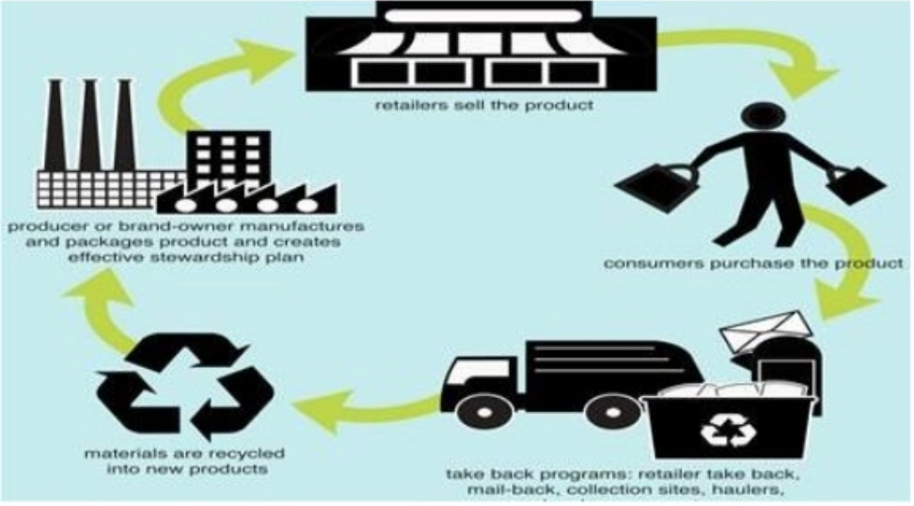

Initiatives
Extended Producer Responsibility

Slide 39
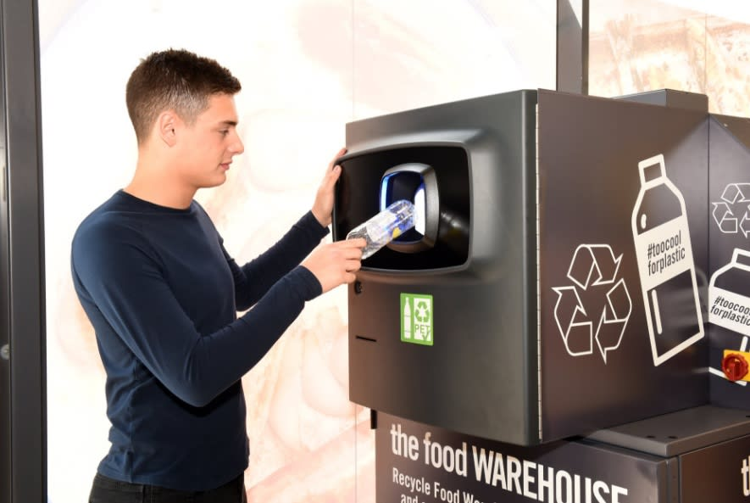
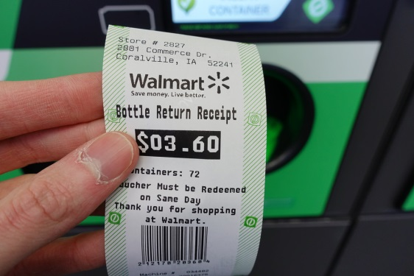
Deposit-refund schemes
A DRS “the surcharge on the price of potentially polluting products. When pollution is avoided by returning the products or their residuals, a refund of the surcharge is granted.”
98.5% of refillable bottles being returned by consumers

Slide 40
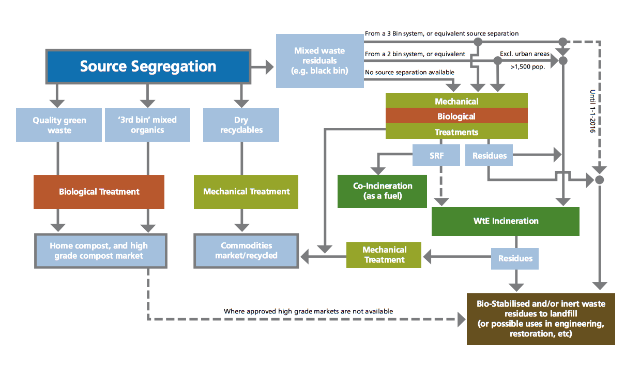
Ban on landfilling un-pretreated MSW
*2005, banning certain types of un-treated municipal waste going to landfill (residual household and industry waste)
REDUCTION 30 Mt of CO₂ last 15 years
Ref:EPA, waste pretreatment path
Notes:
Must treated in mechanical biological treatment plant
National Ministry for Environment, this has led to a reduction of more than 30 million tonnes of carbon dioxide equivalents per year in Germany over the last 15 years
This is to prevent any biological conversion processes from occurring
Source separation (e.g. home composting, packaging waste) n
Separate collections (e.g. ‘3 bin’ systems) n
Diversion to non-disposal waste management routes n
Manual sorting n
Composting n
Energy recovery n
Microechanical treatment (crushing, grading, magnetic separation, eddy current separation, ballistic separation, trommeling, sorting, etc) n
Biological stabilisation of ‘black bin’ residues (after mechanical treatment) n
Rendering n
Thermal treatment (including pyrolysis) n
Aerobic/anaerobic digestion.g so as to reduce landfill gas.

Slide 41

Separate collection of waste
The separate collection of waste is administered using a number of different colour coded bins found at residential homes, university campus and public places such as train stations
Ref:http://www.wiesbaden.army.mil/docs/Waste%20Separation%20Chart.pdf

Slide 42
Proposals for Deans on the waste sorting program of the University of Babylon
1.Allocation of a committee within each faculty to clean the external structure of containers weekly (maintenance, cleanliness, maintenance, supervision). The committee consists of service workers and supervisors for the purpose of follow-up.
2. The container models are presented in the form of PPT to be chosen as a standardized model to be unified in all colleges and under the supervision of the team of the Center for Research and Environmental Studies.
3. The opinion of the deans of the colleges for the number of containers is based on the field visit by the team to all the joints of the university (places need to put containers), which will be based on the number of containers for each college.
4. Containers inside buildings whose dimensions are different from outside buildings and are decided during the session.
5. It is agreed with the deans of faculties on the design of advertising and logo university and instructions of the container.
6. Proposal to erect a large container is an implicit project that includes the collection of clothes, shoes, games, and be permanent.
7.Agreement with the deans to print posters and leaflets awareness guide placed inside the colleges.
8. Holding workshops to educate students about waste sorting programs.
9.Designing a website Within the university site and in contact with the research center site through which to review the updates and continuous updates of events and be linked to the office of Mr. Dean in order to achieve the sustainability of the university.
10. Contract with companies for the purpose of waste disposal and be under the supervision of the working group to document the dealings with external bodies for the purpose of lifting waste.

Slide 43

Grateful thanks

Slide 44
Thanks for your attention

